Slide 1
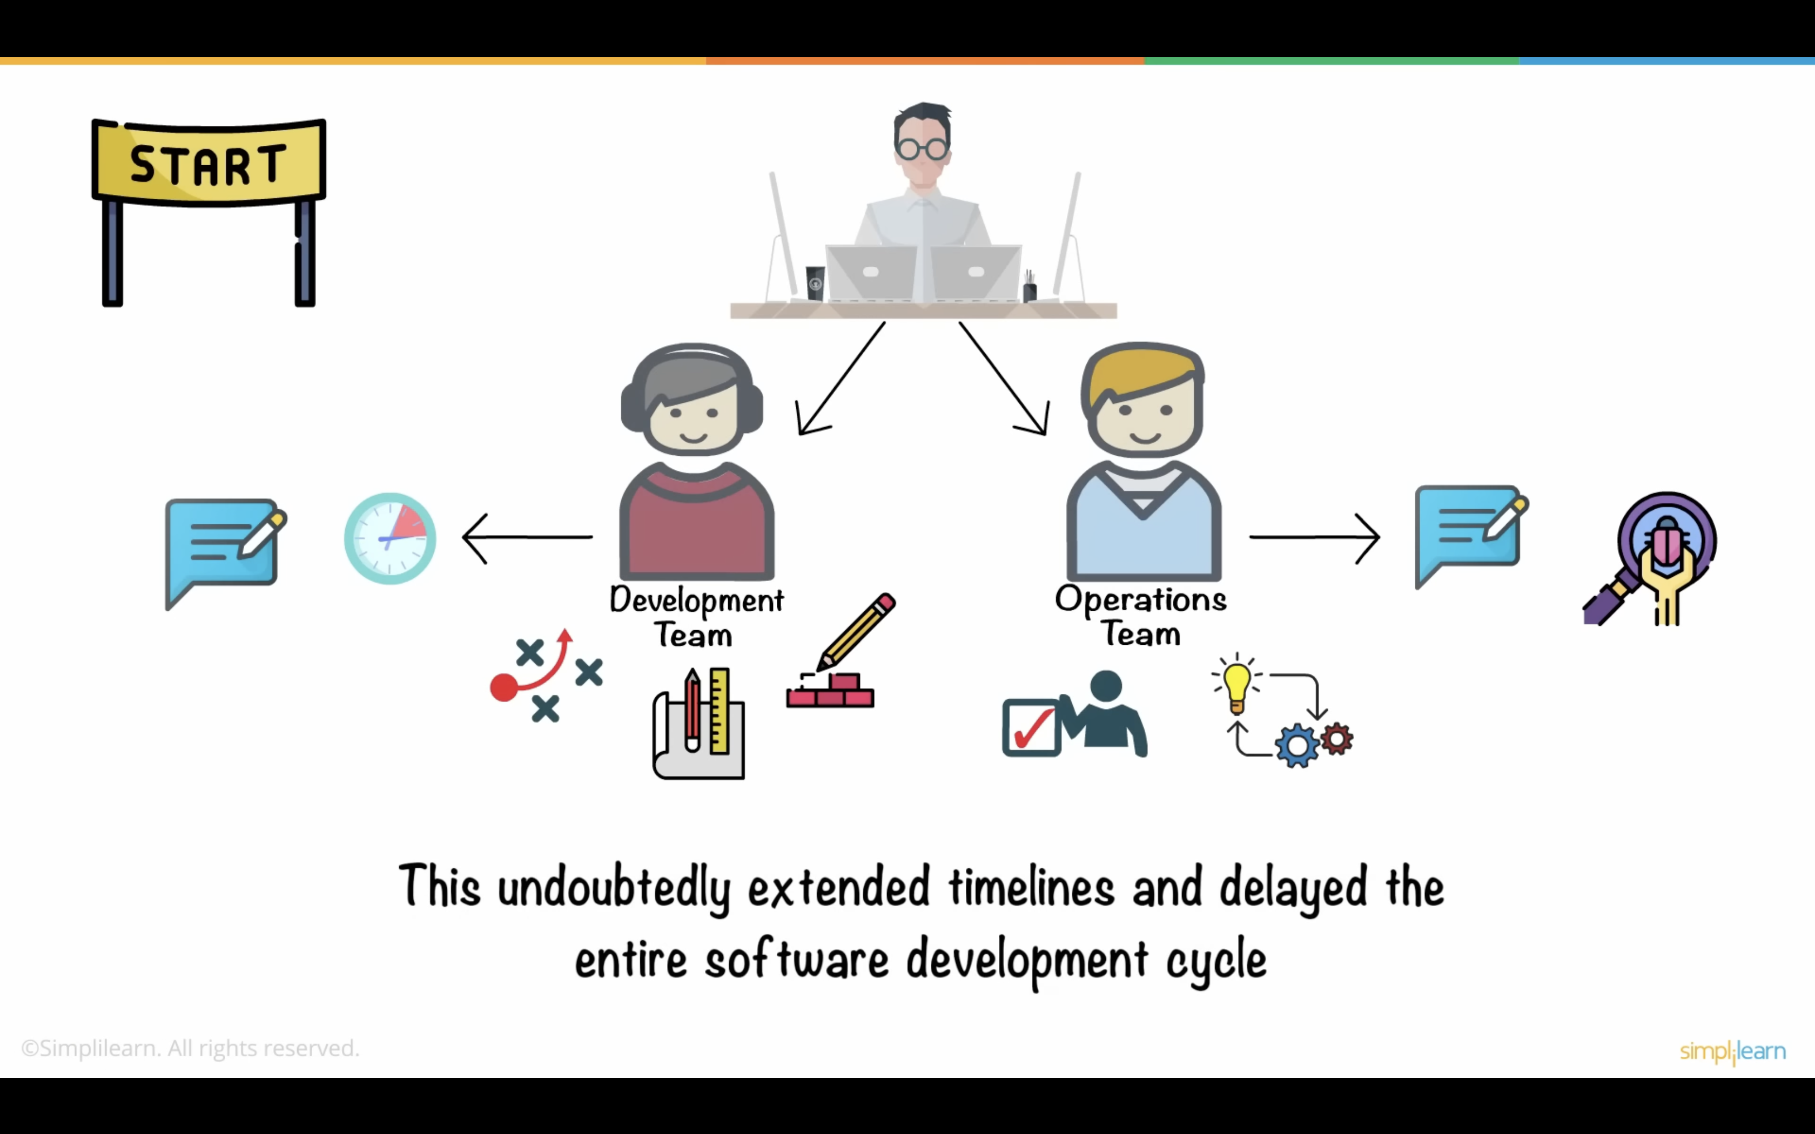
Beginning..

Slide 7
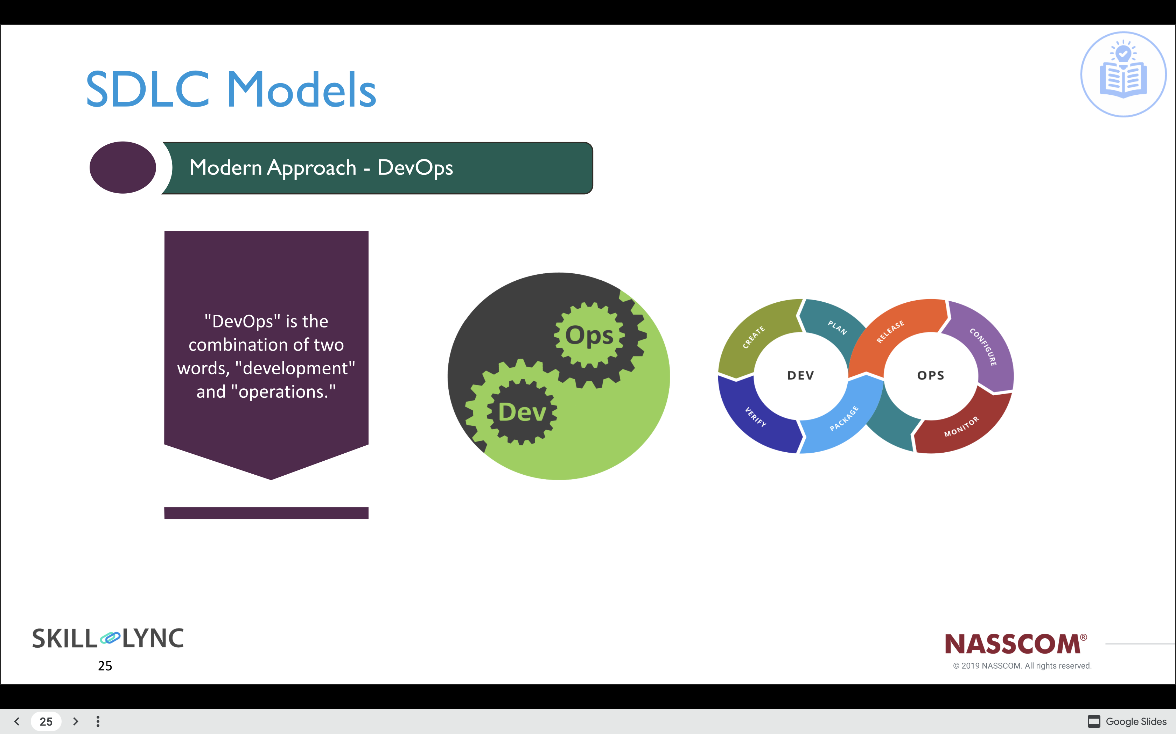
DevOps
Notes:
Good evening, everyone! Today, we're going to talk about a SDLC model called DevOps.
Why do we need DevOps?
Prior to the advent of DevOps, the software development and operations teams operated separately and in isolation. Testing and deployment were carried out separately. came after the program construction, and took longer than the build cycles themselves. Without DevOps, team members spent more time testing, deploying, and creating the project. The majority of the time, manual code deployment causes a human error on the assembly line. Teams working on development and operations have separate schedules. The are unable to create any more delays

Slide 8
DevOps
Notes:
DevOps stands for Development and Operations. It's a way of making computer programs faster, better, and more secure by bringing together the people who make the programs and the people who run them. This collaboration leads to better communication, faster problem-solving, and improved software quality.

Slide 9
DevOps
Notes:
Let's start with the advantages of DevOps. First, DevOps helps to automate tasks and reduce errors, making software production and deployment more efficient. It also helps to make computer programs faster by streamlining the development process. For example, DevOps allows developers to quickly and easily test their code and make changes, so they can get new features out to users more quickly.

Slide 10
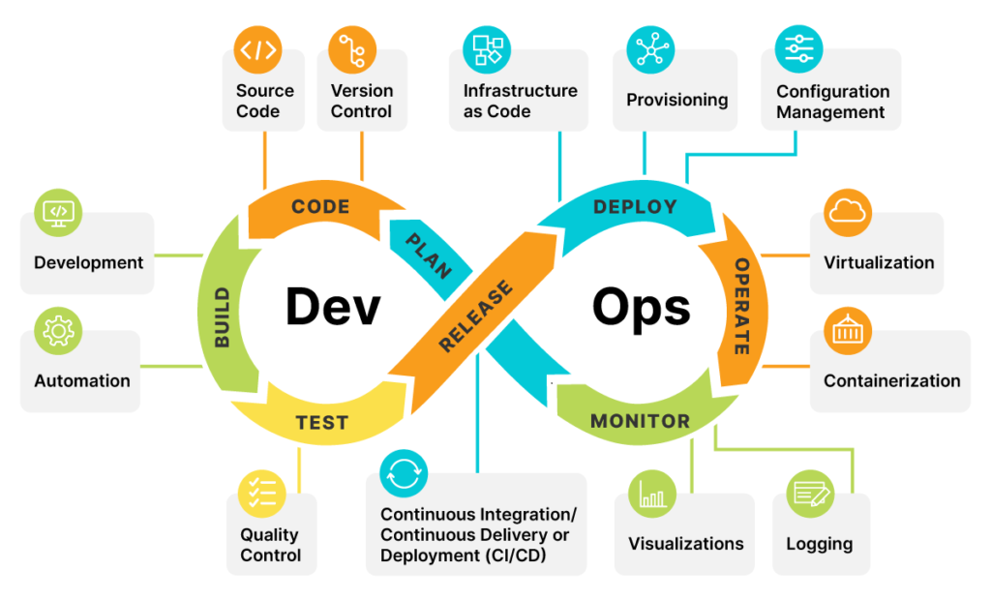
DevOps
Notes:
Another advantage of DevOps is that it helps to improve the quality of computer programs. With DevOps, each step of the development process is checked and tested all the time, so if there's a mistake, it can be found and fixed quickly. This leads to fewer bugs and better software.

Slide 11
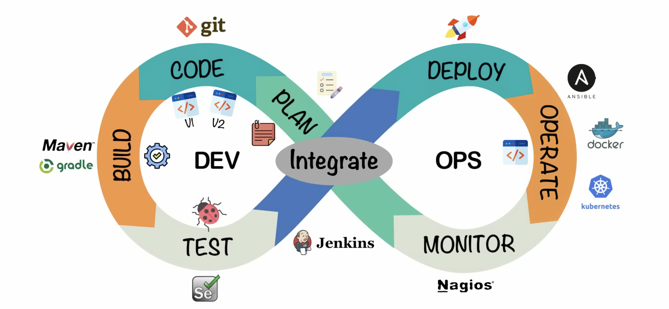
DevOps
Notes:
Finally, DevOps helps to make computer programs more secure. When you use a computer program, you want to make sure your information is kept private and that bad people can't use the program to do bad things. DevOps helps make sure the program is safe by checking it all the time and making sure there aren't any security problems.

Slide 12
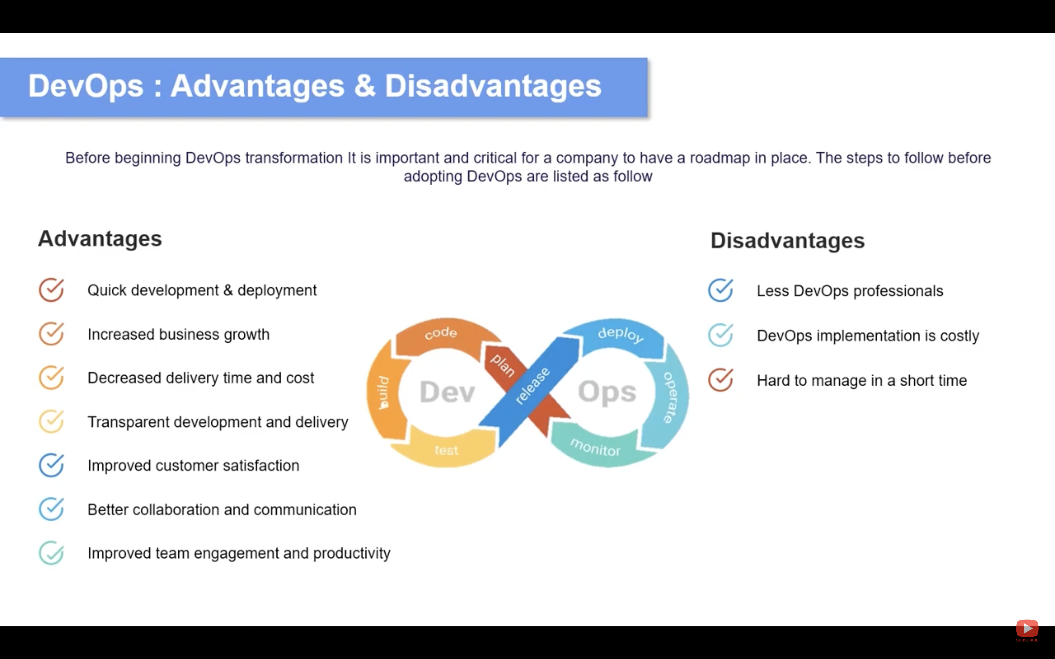
DevOps
Notes:
So, in summary, DevOps is a way of making computer programs faster, better, and more secure by bringing together the people who make the programs and the people who run them. It has many advantages, including automating tasks, improving software quality, and making programs more secure. However, there are also some challenges to implementing DevOps, including changes in organizational culture, a learning curve, and the cost of tools and technologies.

Slide 13
DevOps
Notes:
So, in summary, DevOps is a way of making computer programs faster, better, and more secure by bringing together the people who make the programs and the people who run them. It has many advantages, including automating tasks, improving software quality, and making programs more secure. However, there are also some challenges to implementing DevOps, including changes in organizational culture, a learning curve, and the cost of tools and technologies.

Slide 14
DevOps
Notes:
Now, let's talk about the disadvantages of DevOps. Implementing DevOps requires changes in organizational culture and structure, which can be challenging. There may also be a learning curve for teams that are new to the DevOps approach. Additionally, DevOps tools and technologies can be expensive, which may be a barrier for some organizations.

Slide 15
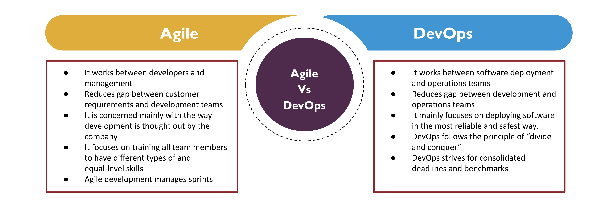
DevOps
Notes:
So, in summary, DevOps is a way of making computer programs faster, better, and more secure by bringing together the people who make the programs and the people who run them. It has many advantages, including automating tasks, improving software quality, and making programs more secure. However, there are also some challenges to implementing DevOps, including changes in organizational culture, a learning curve, and the cost of tools and technologies.

Slide 16
Thank You!

